Slide 1

Step by Step guide to access required resources, for Clubs registered for the YOTY 2019 Competition.
It is VERY important any clubs taking part successfully register, these clubs will then be sent the required Logon and Password.
Please do not share the Logon and Password sent to your club.

Slide 2
https://lionsclubs.org.au/activities/youth/yoty/protected-documents/
Use link above either press link (may work) or copy paste, or type into
Your Web page address bar, normally found at the top of your page, or on Google search

Slide 3
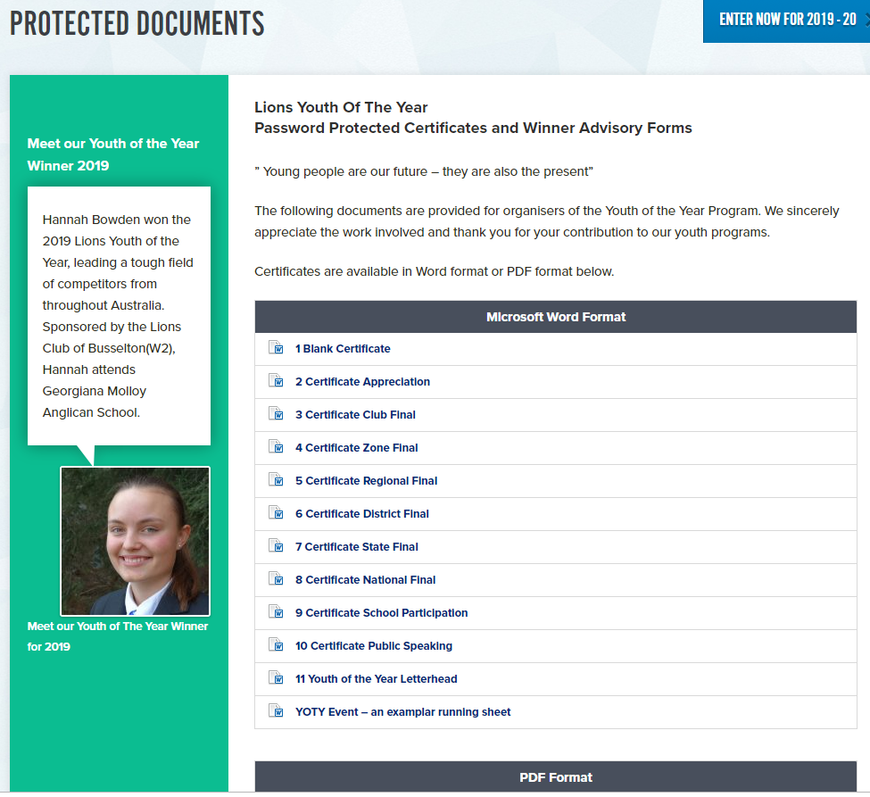
Click on any of the items that you require IE Start at No.1 Blank Certificate

Slide 4
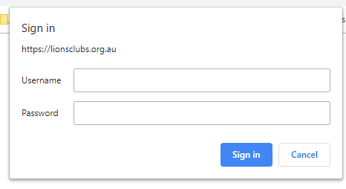
This Pop up window will “pop up”, if it does not please check if you have
a adblocker working that may be stopping it,
if so you will need to pause, this or allow pop ups on this site.
Type in the Logon and Password that I emailed you with this. Press sign.

Slide 5

Now you should be able to access and down load any of the resources that you need. IE Our example Blank Certificate.

Slide 6
Hope this is of some help, any questions please reach out and ask,
thank you
for being one to the special people that put their hands up to put on this great youth activity.
Lion Michael 0412879343 yotyq1@gmail.com Mudgeeraba Lions

